Slide 1






PYTHON
Student Performance Management System
Python Programming – MCA
Submitted by: Aakash Yadav, Akash Kukreti, Shivansh Gupta, Sandeep Kumar
Submitted to: Kunwar Siddharth
Academic Year: 2025-2027

Slide 2











Problem Statement
Manual maintenance of student academic records presents significant challenges for educators and institutions:
Calculation Errors
Record Management
Limited Analytics
Manual calculation of percentages
Difficult to maintain physical records
Lack of performance insights
Error-prone grade assignment
Excel sheets become unwieldy
No automated reporting
Time-consuming average calculations
Manual tracking of student progress
Difficulty in identifying trends
Traditional methods lack the automation and analytical capabilities needed for effective student performance management.
Student Performance Management System
2/6

Slide 3











Objective & Use of the Project
The Student Performance Management System aims to transform academic record management through automation and intelligent analytics.
Process Automation
Smart Evaluation
Automate student record maintenance with intelligent systems that handle data entry, calculations, and reporting with minimal human intervention.
Automatically calculate percentages, averages, and grades while reducing manual errors through validated algorithms and automated workflows.
Data Portability
Performance Insights
Import and export student data seamlessly between systems using standard formats like CSV and JSON, ensuring flexibility and compatibility.
Generate actionable insights through analytics that identify top performers, analyze subject-wise statistics, and visualize grade distributions.
This system eliminates manual record-keeping challenges while providing powerful analytics to improve educational decision-making.
Student Performance Management System
3/6

Slide 4








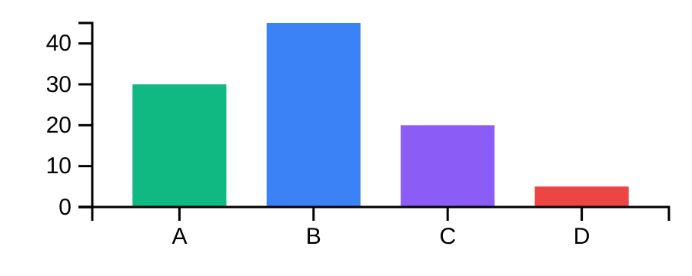








System Features / Functionalities
Student Data Management
Analytics Dashboard
Add student details (ID, Name, Gender, Qualification, Marks)
Top performers ranking
Store and manage data using CSV files
Subject-wise statistical summary (mean, median, min, max)
Grade Distribution
Data Import/Export
Export to JSON for portability
Import data from external CSV files
Built with:
Pandas
NumPy
Matplotlib
GUI Interface
Intuitive interface designed using Tkinter
Seamless user experience for data entry and analysis
Student Performance Management System
4/6

Slide 5























Tech Stack / Architecture
Technology Components
System Architecture
Programming Language
Python
GUI Layer
Libraries
Data Manager
Tkinter
Pandas
NumPy
Matplotlib
Models
Data Storage
CSV Files
JSON Export
Analytics Module
Student Performance Management System
5/6

Slide 6
















Conclusion & Future Scope
Project Achievements
Future Enhancements
Automation
Authentication System
Successfully automates evaluation and record keeping processes
Implement admin/teacher login system for secure access
Cloud Integration
Data-Driven Decisions
Add cloud database support for seamless data access
Enables quick decision-making based on performance analytics
Cross-Platform Access
Develop web and mobile versions for remote access
Error Reduction
Eliminates manual errors and improves overall efficiency
The Student Performance Management System represents a significant step toward modernizing education administration through Python-powered automation.
Student Performance Management System
6/6

